Slide 1
Black Jack: Play the Numbers
♠♥♣♦
Prithika Ganesh, Justin Sadler, Joshua Shterenberg, Tao Zhang

Slide 2
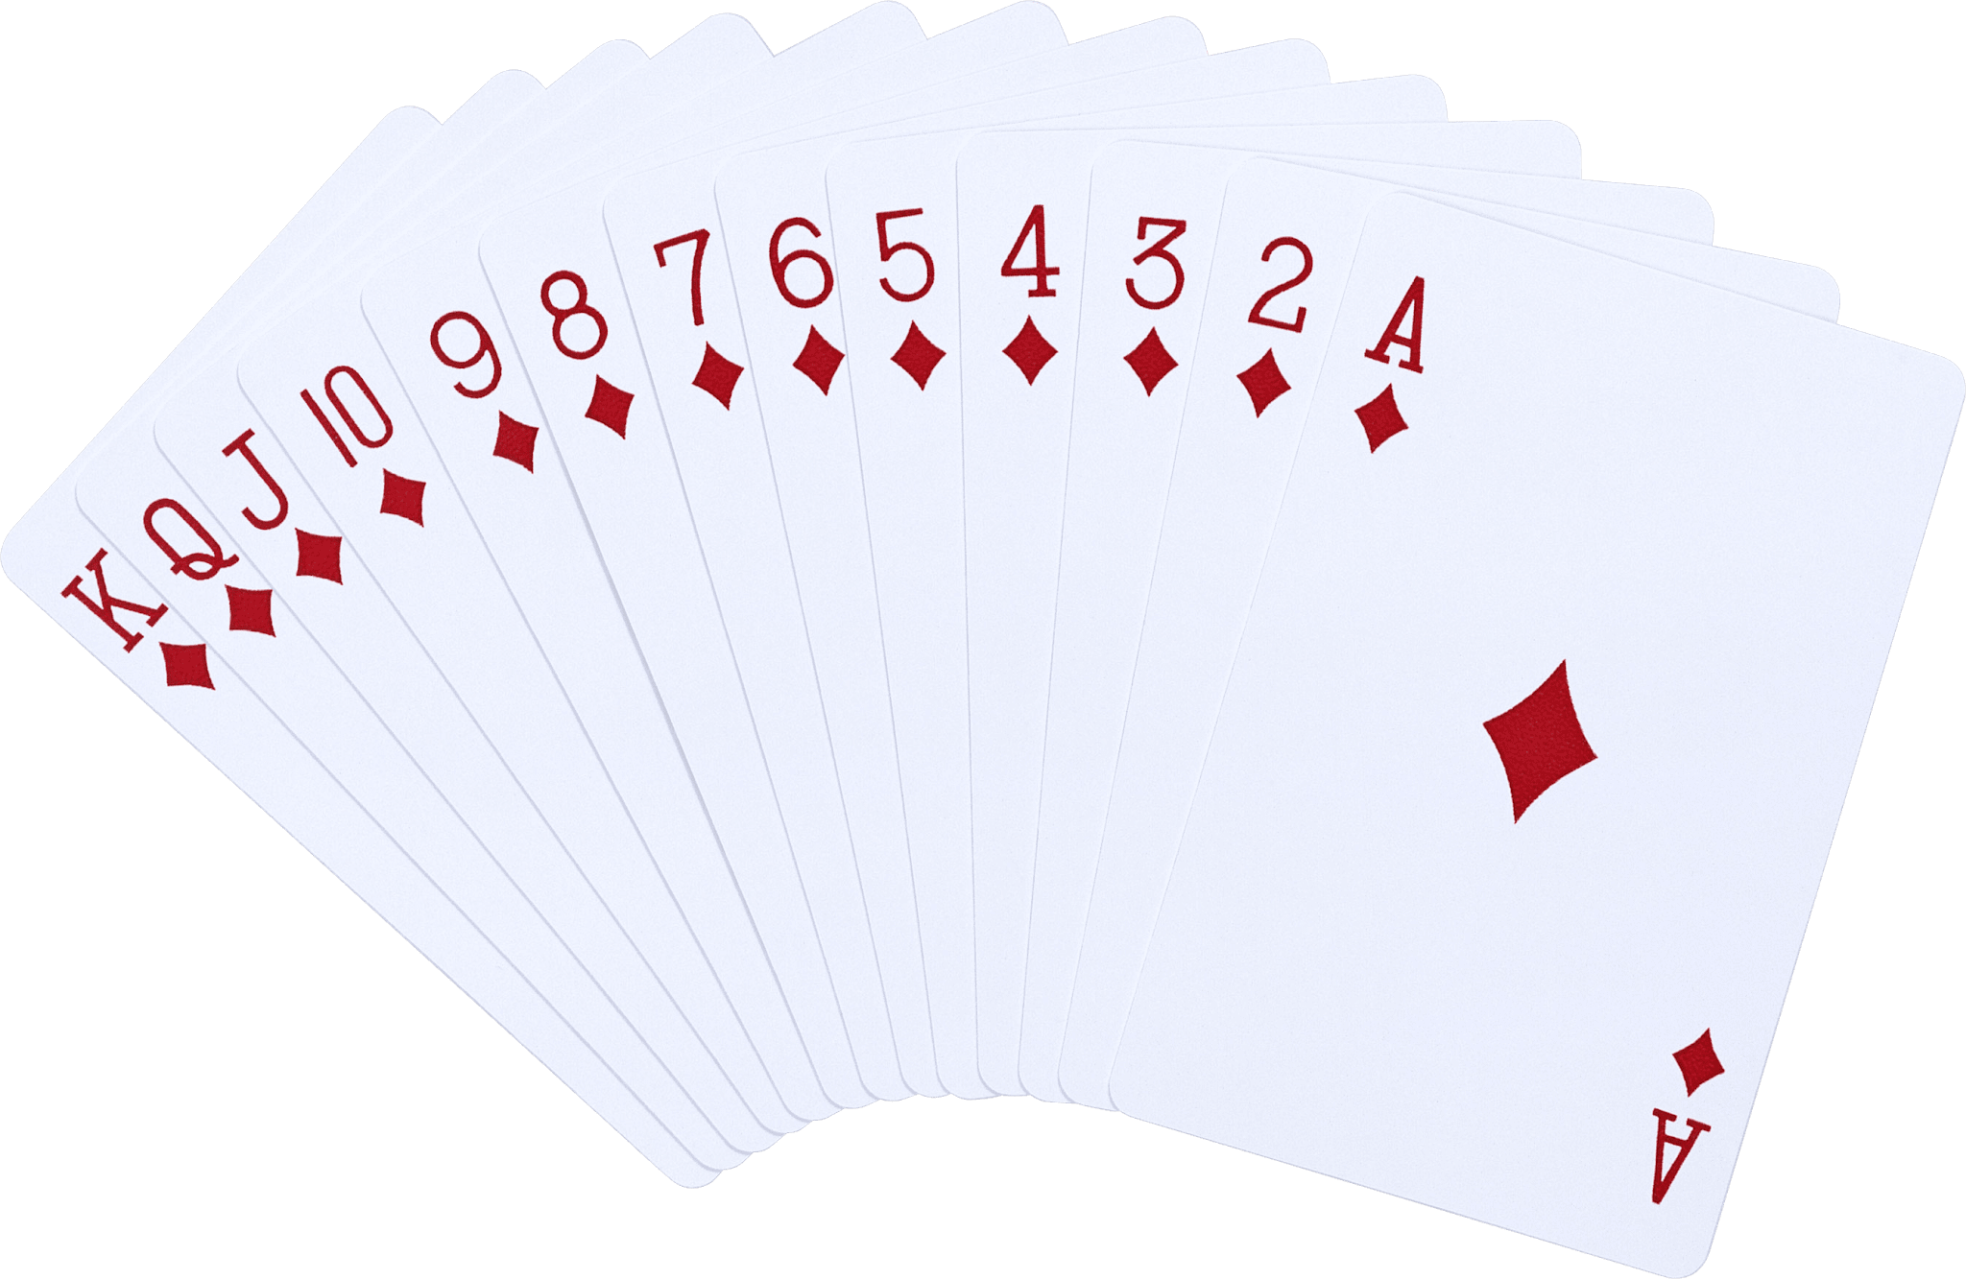
Goals/Motivation
Originated from the classic card game: Blackjack
Doesn’t need a “dealer”, you play solo!
Two parts!
Part 1: single-player game with computer for fun
Part 2: see different levels of performance of different
Thresholds from computer generated games
Fun game and teaches probability!

Slide 3
General Functionality
Random Number Generator
A random sequence of cards (1-52 inclusive) generated each turn
It simulates the points on each card obtained
Timer
10 seconds are given each turn for the player as opportunity cost
If no decision made, the game “hits”, else “stays”.
7-segment Display
shows player’s points, time, and end conditions (everything)
sets “threshold” for the computer in part 2
VGA
display graph illustrating how computer is doing (point values)
after setting the threshold

Slide 4
Brief Specifications/Instructions
FPGA board (with switches/buttons/7-segment display)and a VGA display are needed for I/O
User uses button at start both parts
Points given to the computer and user are a random number
Judgement by user must be done within 10 sec, otherwise indicating “hit”

Slide 5
General Game Flow Diagram
Start Program
Part 1: Play Game
Part 2: VGA Stats
Player Competes with Computer
Computer Competes with itself
Win/Lose in 7-seg Display
VGA showing the results for given Threshold
Notes:
As Tao has mentioned, our program has 2 main parts.
The first is the actual game play. In this mode, a human user plays a single round of black jack against the computer. The result of this game is displayed on the 7-segment display.
The second part, the more unique part of this, is the VGA output. In this part, the computer plays a one-sided game of blackjack against itself when given a certain threshold. After playing 300 simultaneous games, the Computer then outputs the total card count they got onto a graph on the vga.
Now to dive a little more deeply into each of these parts.

Slide 6
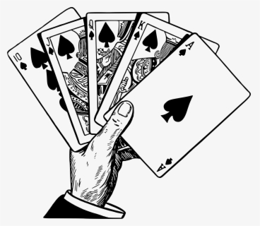
Mode 1 Flow Diagram
Player’s Turn
Start - Player’s Turn
Given Card
Hit or Stand ?
Stand
Hit - Given Another Card
Yes
Computer’s Turn - Compare Results
Accumulated Points ≤ 21?
No
Player Win
Player Lose
Tie
Notes:
So for part 1, the game play obvious has 2 sides to it, what the user experiences as it plays the game, and what the computer goes through while playing the game.
From the user’s end of part 1, the game play works in the follow manner. Once the game starts, the user is given 2 cards that will add up to a certain card total. 4+5 So then the user is given the choice to either hit or stand. Hit meaning take another card, or stand, meaning keep your current card total. Now the user only has 10 seconds to decide if they want to hit or stand. If the user does not make a decision, the game will automatically hit for them.
So if the user decides to hit, they will recieve a new card and new card total. So once they have their new card and the new card total, the program will then decide if the user’s total is still less than 21. If the total is less than 21, the cycle continues and they get to decide whether they want to hit or stand again. If the user’s total is over 21 though, the automatically loose.
The second option the user has to hitting is standing, at which point, the user says they’re good and don’t want any more cards. The program then compares the total the user has to the total the computer has determines the winner.

Slide 7

Mode 1 Flow Diagram
Computer’s Turn
Start - Computer’s Turn
Given A Card
Accumulated Points Less than 15 (Threshold)
Yes - Hit
No - Stand
Yes
No
Compare Results with Player
Accumulated Points ≤ 21?
Computer Win
Tie
Computer Lose
Notes:
From the computer’s end of part 1, the game play works very similarly to how it works on the user’s end with a couple of key differences. Once the game starts and the computer is given 2 cards, the computer then figures out if the total value of their cards add up to something less than 15. 15 in this case is the hitting threshold.
If the value is less than 15, the computer will hit automatically. The computer will then figure out if their total is over 21 or not. And if the total is less than 21, the computer will go back and decide whether they want to hit again or stand based on the hitting threshold. If the total is over 21, the computer loses.
If the total is greater than or equal to 15, the computer will stand and then compare its total card count to the human player’s card count and then determine the winner.

Slide 8
Mode 2 Flow Diagram
Start
User Sets A Threshold
Generates game # and value
Computer Plays Itself for 300 Turns
Adds to plot
Output (Plot)
Notes:
The second part, the VGA graph, is a bit more interesting and relies on the same computer game play algorithm from the previous slide.
So once the program starts, the user inputs a value for the threshold using switches on the fpga. The computer then plays 300 one sided game of blackjack with that threshold. The program then simultaneously plots the total card count of these 300 games on a graph on the vga, giving the user an idea of the statistically probable outcome for the range of values they will get when choosing a certain threshold value.

Slide 9
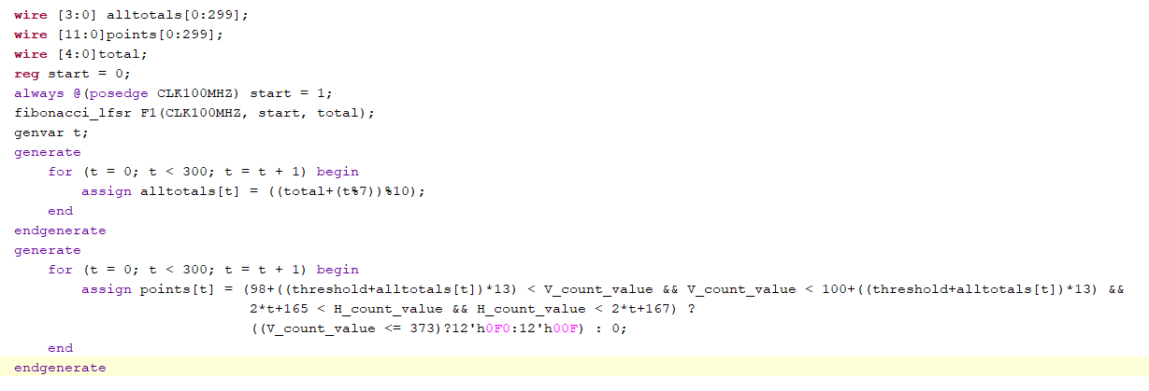
Code Snippets!
Displaying Runs
LFSR Implementation
LFSR -> Random Array
provide 1 or 2 of your best code snippets and discuss. What was unique
about it? Challenging? Innovative?
Notes:
provide 1 or 2 of your best code snippets and discuss. What was unique
about it? Challenging? Innovative?

Slide 10
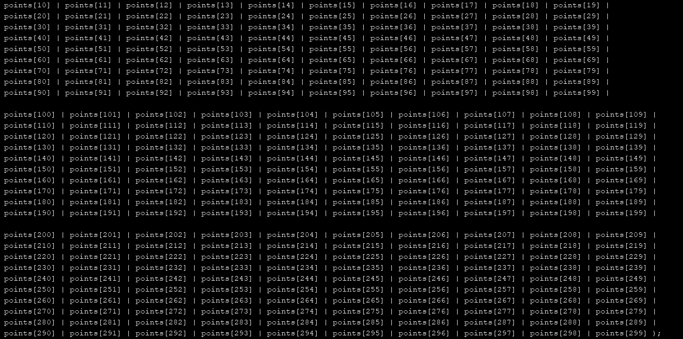
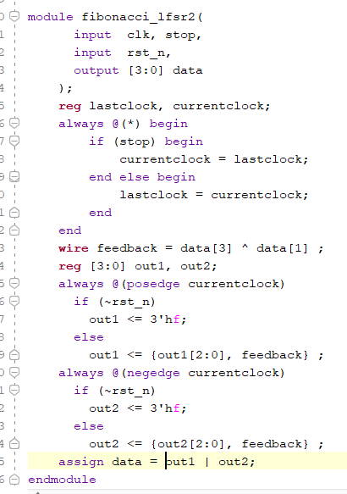
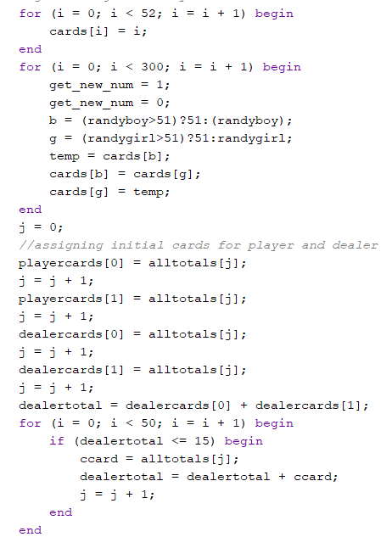

Slide 11
Successes!
More interesting BlackJack!
Managed to create tension in game with timer instead of betting. And the timer itself works well.
7-segment display showing the process of the games played between the user and the computer, successful timer and addition of systems.
The FPGA graphics are amazing
Random generator is basically as good as it can be
VGA demonstrating the results of the game played
between the computer and itself

Slide 12
Failures
Had to switch our method of getting new cards from getting them from a deck to purely random, which allows for repetition in the long run.
A lot of unlabeled switch inputs (more of an inconvenience than a failure).
Sometimes the reset button glitches
Keyboard Input wasn’t implemented
Reset of system while on to switch between modes
No switching between modes, happening at the same time
(mostly setback)

Slide 13

Video Demonstration

Slide 14
Solutions
Include a larger range for the random numbers so it “feels” like we’re getting them from a deck in the short term and is doesn’t repeat. The temporary fix was fine because the user only needed 10 cards.
For the unlabeled inputs, we will display on the VGA what they operate.
Reset button needs to be driven by a finite state machine module instead of purely by the logic of the program.

Slide 15
Next Steps
Add functionality for standard deviation, mean, etc. for more details about the win/loss ratio, all the solutions above,
Implement a better random generator that models a
deck of cards
Implement a mouse input for the player to hit or stand during his/her turn in mode 1. Implement keyboard input for the threshold
Implement a finite state machine to control the different modes of operation and the VGA.
Using the VGA to display their card total and the whether the user won or lost

Slide 16
Thanks for listening!!!
Any questions? ♠♥♣♦

